Slide 1

Oncology – US Strategic Data and Digital
Detecting Metastatic Breast Cancer and Therapy Patient Transitions through Data
Team: BreastFriend
Adeboye A. Adejare Jr.
Chadakarn Sirasitthichoke
Shaoqing Zhang
Yves Greatti

Slide 2
Presentation Outline
Introduction
Problem Statement
Materials
Methods
Results
Objective 1
Objective 2
Discussion
Limitations
Conclusion

Slide 3
Introduction
Notes:
Breast Cancer (BC)
Second most common form of cancer for women
250,000 women diagnosed each year
42,000 women die each year
Metastatic Breast Cancer (mBC)
Cancer left over when treatment is done
Transitions into invasive BC
6% will be diagnosed with mBC

Slide 4
Introduction
Breast Cancer (BC)
Second most common form of cancer for women
250,000 women diagnosed each year
42,000 women die each year
Metastatic Breast Cancer (mBC)
Cancer left over when treatment is done
Transitions into invasive BC
6% will be diagnosed with mBC
Notes:
Breast Cancer (BC)
Second most common form of cancer for women
250,000 women diagnosed each year
42,000 women die each year
Metastatic Breast Cancer (mBC)
Cancer left over when treatment is done
Transitions into invasive BC
6% will be diagnosed with mBC

Slide 5
Introduction
Biomedical informatics approach
Real world data can provide insight into Breast Cancer (BC)
Predict transition to metastatic (mBC)
Show effectives of treatment and possible treatment transition
Machine Learning
Models can give guidance into progression of disease and treatment
Leverage patient data to create models

Slide 6
Problem Statement
How can we identify BC patients who become mBC patients and assess treatment transition from 1st to 2nd Line therapy?
Objective
Predict patient transition from BC to mBC
Predict when patient on a medication will transition from 1st to 2nd line therapy

Slide 7





Materials

Slide 8
Methods
RX
PX
Diag
Combine Data
Clean Data
Prepare Data
Test/Train (sk-learn)
Regression
Random Forest
Neural Network
eXtreme Gradient Boosting

Slide 9
Methods
Clean data
Identify relevant ICD/procedure codes
Remove non-contributive data
Duplicate procedure codes, descriptions, etc.
Natural Language Processing to identify relevant body part information
Prepare data
Leverage NLP and procedure codes to identify mBC target points and create data columns
Categorized relevant data
Leverage Healthcare.ai’s to isolate important variables

Slide 10
Methods
Machine learning
Data split 75/25 Testing Training Random Parameter = 42
Linear Regression
Random Forest
eXtreme Gradient Boosting
Neural Network

Slide 11
Methods
Objective 1 Covariates
Diagnosis Codes
Procedure Codes
Body parts associated with Procedure codes
Seasonal data
'BC_PATIENT’, 'mBC_PATIENT',
Objective 2 Covariates
Therapy (1st Line or 2nd Line)
Breast cancer treatment medications
Days on treatment
'BC_PATIENT’, 'mBC_PATIENT',

Slide 12
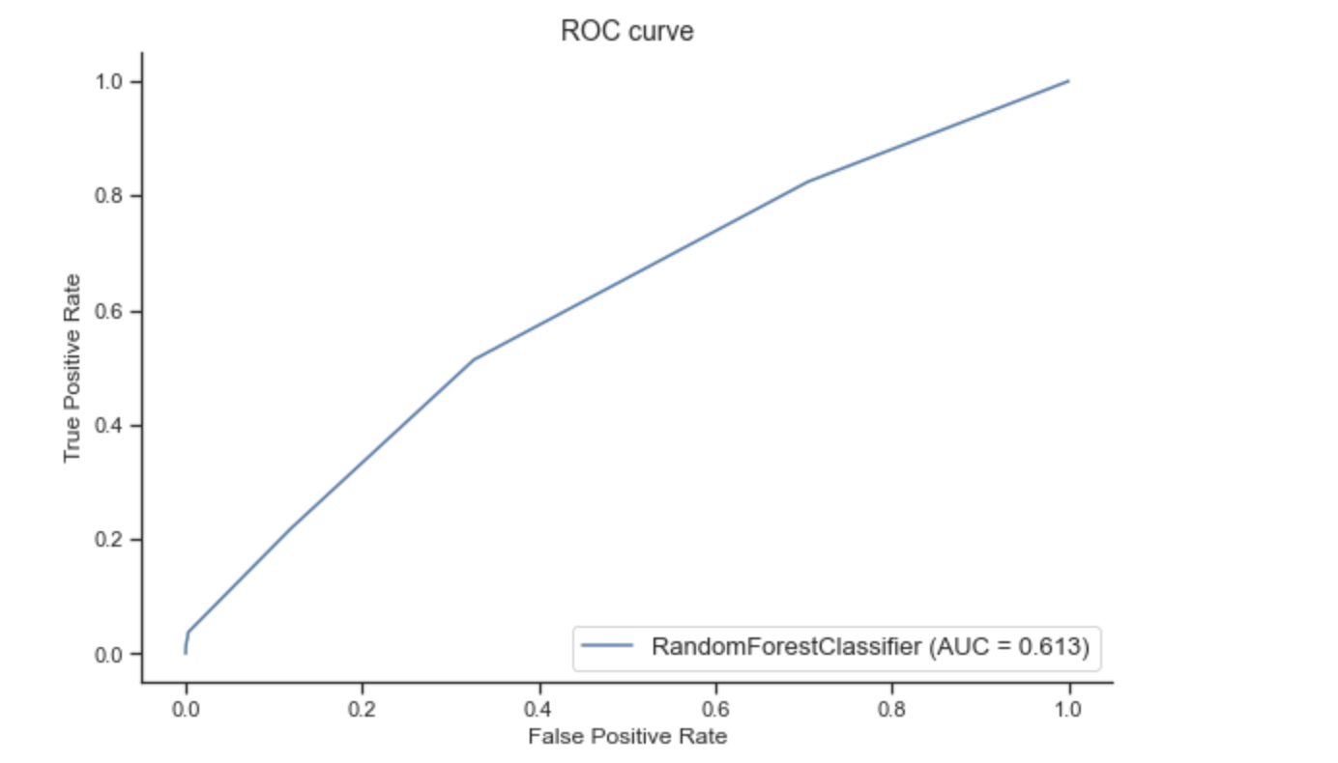
Results– Objective 1
Random Forest
Testing Accuracy: 0.9698
Sensitivity: 0.9970
Specificity: 0.929
Contributing Factors:
Season
Body parts:
blood, bone, breast, heart, lungs
Medication
PRC_STD_CD code

Slide 13
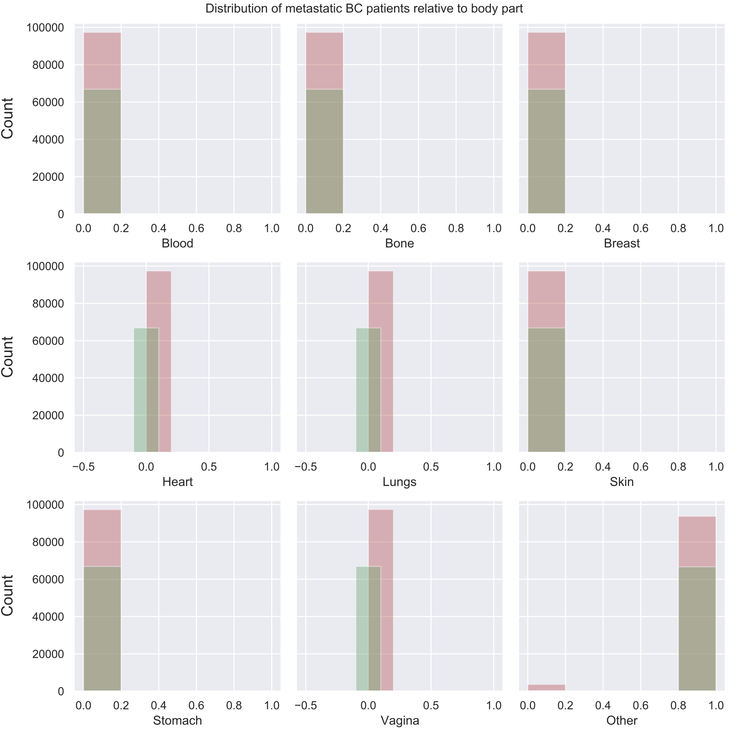

Slide 14
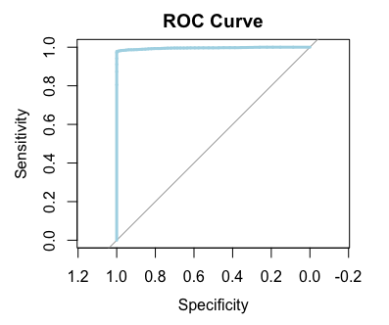
Results – Objective 2
eXtreme Gradient Boosting
Test Accuracy: 0.9932
Sensitivity: 0.9785
Specificity: 1.0
Contributing factors:
Days on first treatment
Ibrance (IBR)
Letrozole (LET)
Xeloda (XEL)

Slide 15
Ibrance – Has specific designation for HR+ breast cancer (aggressive form of mBC)
Xeloda – Second line of therapy to UK and
Letrozole- Breast cancer treatment for post-menopausal women (aromatic compound that can be used in combination)

Slide 16
Discussion
Ensemble models performed the best
Showed best in Sensitivity and Specificity
Probable accurate models for the data given with caveats
Time based data
Seasonal data had some impact on Objective 1
Time on first line of therapy had some impact on Objective 2
Casual Inference
No variable has causal effect on outcome variable

Slide 17
Limitations
Health data sparsity
Patient co-morbidities/previous health history
Breast cancer type (e.g. triple negative)
Demographic data
Pay could infer a bit demographics

Slide 18
Conclusion
Predicted mBC with
Season, medications, body parts and procedure codes were the factors most associated with model
Predicted transitions from 1st to 2nd line therapy
Days on therapies and certain drugs (XEL, IRB, LET) were the drugs associated with the transition
Model can improve knowledge on treatments and mBC identification

Slide 19
Oncology – US Strategic Data and Digital
Thank You
Q & A

